Slide 1

WEB SERVER

Slide 2

WEB SERVERS
INT202 – Internet Infrastructure Applications

Slide 3

Web Hosting Page XX - YY
Artwork by Lisa Haney
Notes:
Rev. 2010-09-25
3

Slide 4



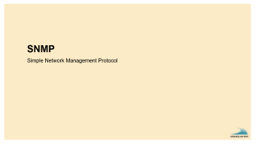
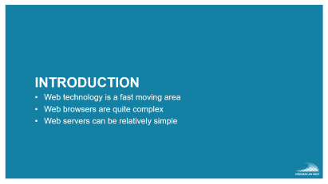







WEB

Slide 5
Introduction
Web technology is a fast moving area
Web browsers are quite complex
Web servers can be relatively simple

Slide 6
HOW A WEBSERVER WORKS
Client (browser) contact the webserver
HTTP-request (URL)
Server fetches from the harddrive, or creates on the fly, a file
Server sends the file as a response
Connection closed

Slide 7
URL - Uniform Resource Locator
Address to an object or a service
http://xxx.xxx.yy:port/directory/file.txt
http://www.hv.se:777/pub/file.txt
Protocol or application
Hostname (computer address)
TCP-port (opt)
Directory (opt)
File name (opt)
Protocol: http, https, ftp, file, mailto

Slide 8
REQUEST
A TCP connection is created to the server
Client sends text command (one or a few lines). For example: GET /index.html
Server sends HTML-file back
telnet www.google.se 80 GET /

Slide 9
HTTP v1.1
Supports “name based virtual hosts”
Supports “multiple requests in the same session”
telnet www.hv.se 80
GET /index.html HTTP/1.1
Host: www.hv.se
<Emtpy line>

Slide 10

HTTP v2 / HTTP v3
HTTP v2
2015
Single connection
Server push, header compression, etc
HTTP v3
QUIC protocol (Not TCP !!)
Header compression
Multiplexing
QUIC is designed to obsolete TCP at the transport layer for many applications, thus earning the protocol the occasional nickname "TCP/2”

Slide 11
HTML – The Language
HTTP transfers .HTML files
Structure of the HTML Language
Generating .HTML-files with a program – On the Fly

Slide 12

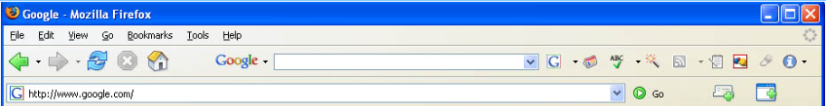


HTML-kod
RESULTERANDE BILD AV HTML-KOD (Rendering)
<!DOCTYPE html> <html> <body> <h1>My First Heading</h1>
<p>My first paragraph.</p>
<p> <a href="http://www.google.com"> Att googla </a> </p>
<p> <img src="chef.jpg">
</p>
</body> </html>
My First Heading
My first paragraph.
Att googla
index.html fil

Slide 13
Generate HTML “on the fly”

Slide 14

DYNAMIC PAGES
HTML files can be generated “on the fly” - using external programs or by the webserver.
PHP (PHP Hypertext Preprocessor)
A common language to generate dynamic content
Can be embedded in the HTML code.
CGI (Common Gateway Interface)
A script is executed on the server (could be Python)
Standard output from the script is sent to the browser

Slide 15
PHP – EXAMPLE (TEST.PHP)
<html>
<head><title>Test of PHP</title></head>
<p>Here is some generated text:</p>
<?php
phpinfo();
?>
<p>Ending text.</p>
</html>

Slide 16
CGI EXAMPLE
/var/www/cgi-bin/thedate.py
#!/usr/bin/python3
from datetime import datetime
print("Content-type: text/plain")
print( " " )
justnu = datetime.now()
print("Today is", justnu)
/var/www/cgi-bin/thedate.sh
#!/bin/bash
echo Content-type: text/plain
echo " "
justnu=`date`
echo "Today is " justnu

Slide 17

APACHE
The Apache Software Foundation

Slide 18
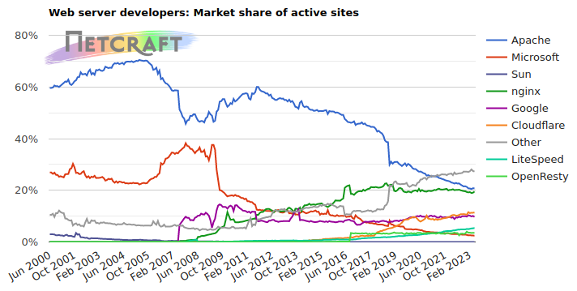
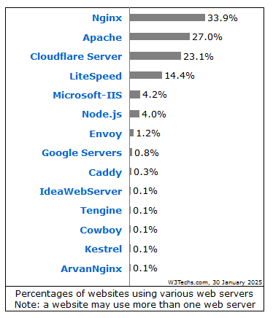
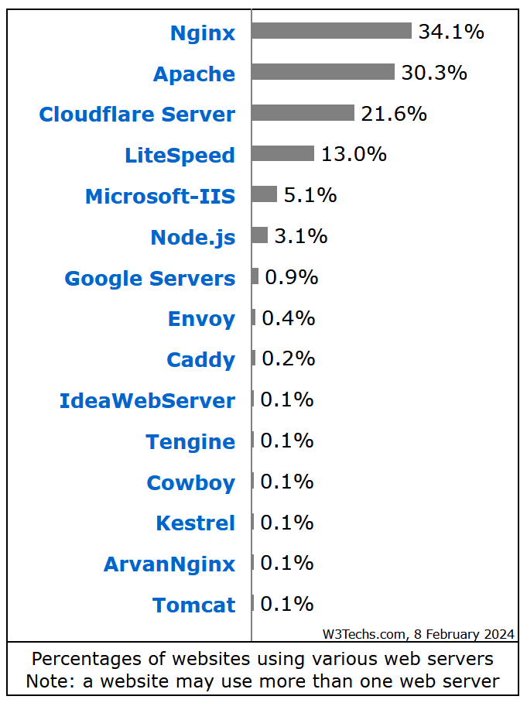
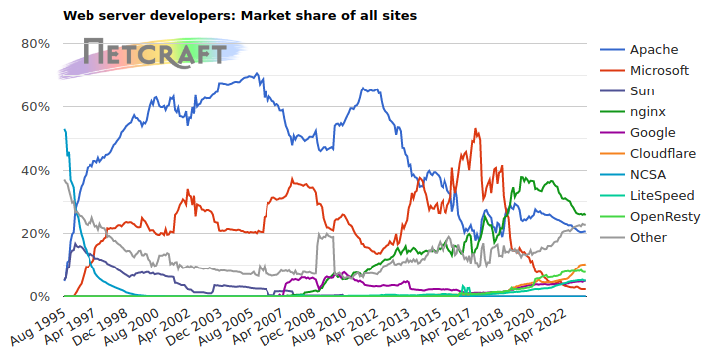
WEB SERVERS
https://w3techs.com/technologies/overview/web_server/all

Slide 19
APACHE CONFIGURATION
Deamon name apache2 (/usr/sbin/apache2)
Files: apt install apache2
/etc/apache2/apache2.conf
/etc/apache2/*/*
/var/log/syslog
/var/log/apache2/*
/var/www/*/*
Notes:
/var/www/*/*
/var/www/www.grp12.lab.hv.se/index.html
/var/www/vvv.grp12.lab.hv.se/index.html

Slide 20

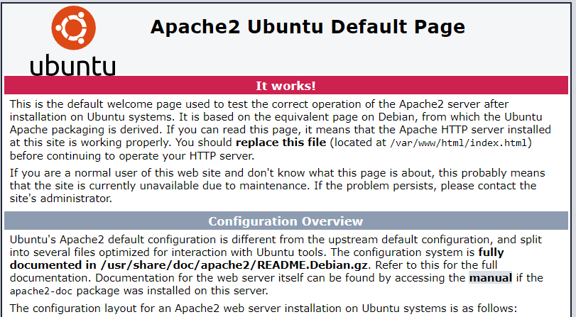
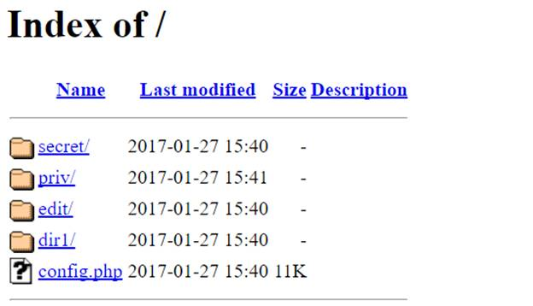
CONTENTS
If no file is specified, index.htm[l] is used
www.hv.se/file.txt
www.hv.se/index.html
www.hv.se/
If the file is not found in /var/www/html
The webserver shows /var/www/error/noindex.html
404 Not Found

Slide 21
GLOBAL SETTINGS
ServerRoot ”/etc/apache2”
Points to the configuration file directory
Listen 80 Listen 443
“Default” TCP port to listen to
LoadModule
Extra functionality (modularity)
Directory
Options, Indexes, AllowOverride

Slide 22
MAIN
<VirtualHost *:80>
ServerName www.example.com
ServerAdmin webmaster@localhost
DocumentRoot /var/www/html
ErrorLog ${APACHE_LOG_DIR}/error.log
CustomLog ${APACHE_LOG_DIR}/access.log combined
</VirtualHost>

Slide 23
Virtual Host Configuration block
<VirtualHost *:80> To handles the HTTP request to our virtual host
ServerAdmin asdf0001@student.hv.se E-mail of the admin for error reporting
ServerName www.grp99.lab.hv.se The name of our new created domain
DocumentRoot “/var/www/html” Defines the root directory where the website's files
ErrorLog … Location of the log server error
CustomLog … Access log, records incoming requests.
</VirtualHost> Closes the VH block the end

Slide 24

Web Hosting

Slide 25



Web Hosting
fiat
opel
volvo

Slide 26
DOMAIN–SERVER CONNECTION
volvo
fiat
opel
Normal (old way): one server – one domain
Ex: www.sunet.se was one computer with one IP-address
If one server is not enough
Load balancing between hardware
DNS load-balancing (www is associated with several IP-addresses)
If one server is too much - one server can be responsible for several domains
Better resource usage (at low loads)
Web hotels
volvo
volvo
fiat
opel

Slide 27
LOAD BALANCING
;; ANSWER SECTION:
www.hv.se 0 CNAME www.l.hv.se
www.l.hv.se 65 A 193.10.236.110
www.l.hv.se 65 A 193.10.236.111
DNS load balance
”Gateway” load balance
Content based
;; ANSWER SECTION:
www.hv.se 0 CNAME www.firstpage.hv.se
www.firstpage.hv.se 65 A 193.10.236.110
www.disco.hv.se 65 A 193.10.236.111
www.schema.hv.se 65 A 193.10.236.112

Slide 28
CISCO IOS SERVER LOAD BALANCE (SLB)
ip slb serverfarm cnap-web
real 193.10.203.21 inservice
real 193.10.203.22
inservice
ip slb vserver cnap-park
virtual 193.10.203.20
serverfarm cnap-web
inservice
.21
.20
Cisco
.22

Slide 29

SHARING DOMAINS ON ONE SERVER TWO+1 SOLUTIONS
IP-based virtual hosting
Virtual interfaces
Several IP-addresses for each computer
Each IP-address has its own DNS name
Name-based virtual hosting
Different DNS names points to the same IP-address
HTTP 1.1 “Host:” header line in request informs the server about the actual domain to serve
Port-based virtual hosting
Different ports lead to different web pages

Slide 30
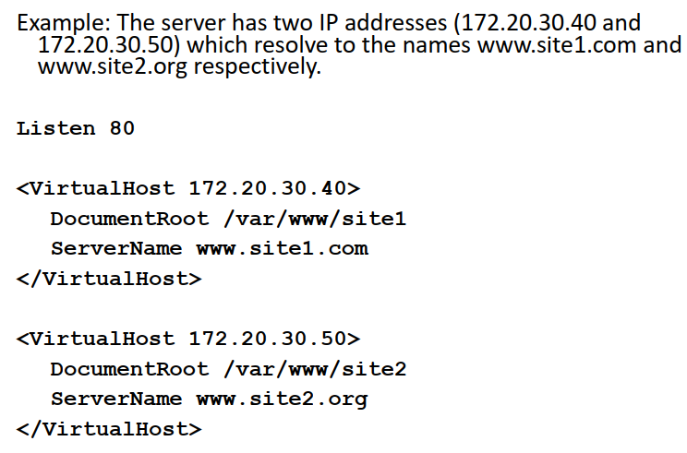
IP-BASED virtual hosting

Slide 31
IP-BASED virtual hosting (2) ERROR
CREATE A VIRTUAL INTERFACE
The (first) networkcard is /dev/eth0 or /dev/ens18
It is bound to an IP-address in the file
/etc/netplan/…
Create copies ”subinterfaces” …
ifcfg-eth0:0
ifcfg-eth0:1
ifcfg-eth0:2

Slide 32
ifcfg-eth0:* (bold == change) ERROR
DEVICE=eth0
BOOTPROTO=none
BROADCAST=193.10.237.47
IPADDR=193.10.237.42
NETMASK=255.255.255.248
NETWORK=193.10.237.40
ONBOOT=yes
TYPE=Ethernet

Slide 33
PORT-BASED VIRTUAL HOSTING ERROR
Example: The server has one IP addresses, but map the names www.site1.com and www.site2.org to 8000 and 8080 respectively.
Listen 8000
Listen 8080
<VirtualHost *:8000>
DocumentRoot /var/www/site1
ServerName www.site1.com
</VirtualHost>
<VirtualHost *:8080>
DocumentRoot /var/www/site2
ServerName www.site2.org
</VirtualHost>

Slide 34
IP-BASED VIRTUAL HOSTING ERROR
Example: The server has two IP addresses (172.20.30.40 and 172.20.30.50) which resolve to the names www.site1.com and www.site2.org respectively.
Listen 80
<VirtualHost 172.20.30.40>
DocumentRoot /var/www/site1
ServerName www.site1.com
</VirtualHost>
<VirtualHost 172.20.30.50>
DocumentRoot /var/www/site2
ServerName www.site2.org
</VirtualHost>

Slide 35
NAME BASED VIRTUAL HOSTS
No need to touch the network interfaces
Saves IP-addresses
Requires HTTP/1.1 support
Map all domains to same IP in the DNS-server (CNAME or multiple A records):
www.site1.com IN A ipnumber www.site2.org IN A ipnumber
Better use of DNS
www.site1.com IN CNAME server1337.lab.hv.se www.site2.org IN CNAME server1337.lab.hv.se
server1337.lab.hv.se IN A ipnumber

Slide 36
APACHE CONFIGURATION EXAMPLE
# Ensure that Apache listens on port 80
Listen 80
# Listen for virtual host requests on all IP addresses
NameVirtualHost *:80
<VirtualHost *:80>
DocumentRoot /www/site1
ServerName www.site1.com
# Other directives here
</VirtualHost>
<VirtualHost *:80>
DocumentRoot /www/site2
ServerName www.site2.org
# Other directives here
</VirtualHost>

Slide 37
Secure HTTP
https://

Slide 38
HTTP vs HTTPS
HTTP is sending everything in clear text
That is of course bad
Login information and passwords can be snooped
Credit card numbers can be spied on
Anyone who can be man-in-the-middle can inject data to your browser, for ex. Malware
HTTPS uses SSL/TLS (Secure Sockets Layers)
Same as ssh does
Normally uses port 443 (instead of 80)

Slide 39


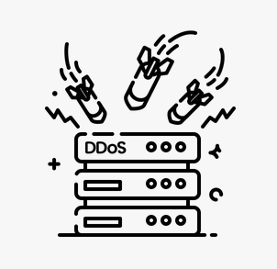


C I A
Confidentiality, Integrity, Availability
H T T P S
Read, Write or Change, Attack
Notes:
https://www.flickr.com/photos/vintage_illustration/42827711582
https://www.vecteezy.com/free-vector/writing-icon
https://www.flaticon.com/free-icon/ddos_8293455?related_id=8293446&origin=search

Slide 40
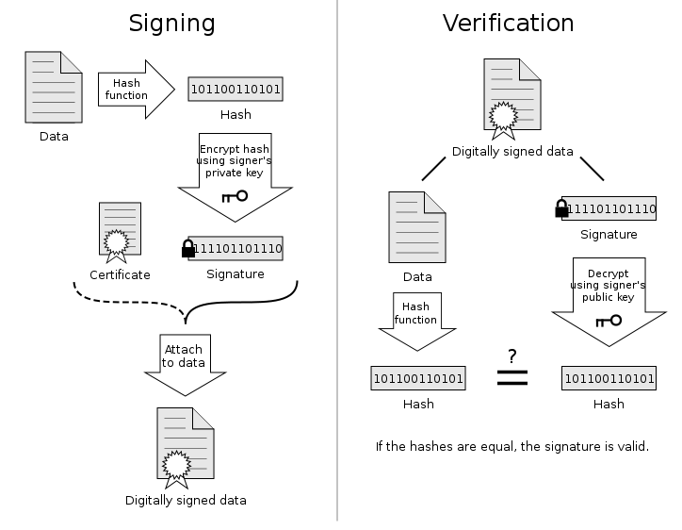
Public & Private is a pair Asymmetric keypair (not symmetric)
http://en.wikipedia.org/wiki/Digital_signature

Slide 41
LEVELS OF SECURITY
Unregistered (self signed) HTTPS-server
Traffic is encrypted
Registered (signed) HTTPS-server
Server is also authenticated
… which really means that it has access to the unique private key guaranteed by a trusted third party to belong to a certain organization or company…

Slide 42
REGISTERING process
The owner of a web site
Generate an CSR – Certificate Signing Request
A trusted source (CA – Certificate Authority)
Signs the certificate and sends it back
Web browser or OS have built in lists of CA:s
E.g. Verisign, DigiCert, Addtrust, Globalsign

Slide 43
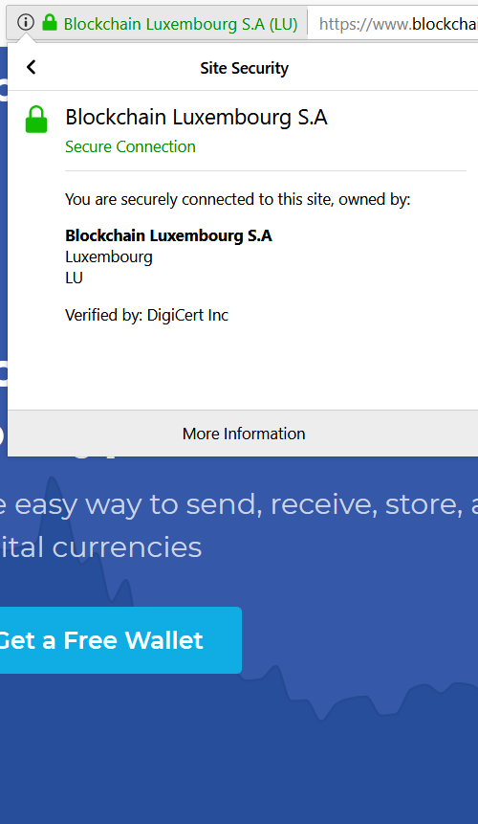
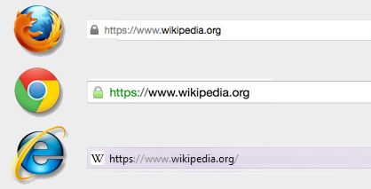
IN THE WEB BROWSER
Will show if on a secure page
Popular: Pad lock icon
And if it is from a trusted source or not
Red coloured URL-field
Pop-up warning
Picture Source: https://blog.easynews.com/http-vs-https-whats-the-difference/

Slide 44
GENERATING AND SELF SIGNING A CERT
openssl
https://www.sslshopper.com/article-most-common-openssl-commands.html
openssl req -x509 -nodes -days 365 –sha256 \
-newkey rsa:2048 -keyout privateKey.key \
-out certificate.csr
Important information:
Common name: machinename.grpX.lab.hv.se
Email address

Slide 45
SNMP
Simple Network Management Protocol

Slide 46
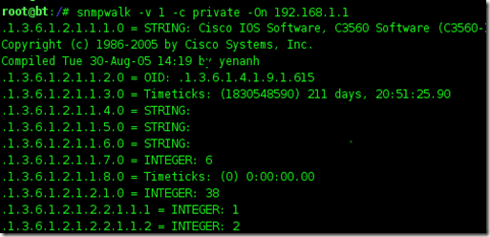
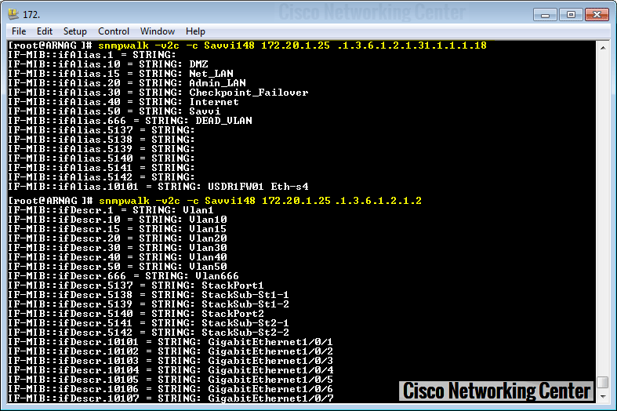
snmpwalk

Slide 47
GET table row SNMPGET
$ snmpget -v3 -l authPriv -u usr-md5-des -A authkey1 -X privkey1 demo.snmplabs.com IF-MIB::ifInOctets.1 IF-MIB::ifOutOctets.1
from pysnmp.hlapi import *
iterator = getCmd(
SnmpEngine(),
UsmUserData('usr-none-none'),
UdpTransportTarget(('demo.snmplabs.com', 161)),
ContextData(),
ObjectType(ObjectIdentity('IF-MIB', 'ifInOctets', 1)),
ObjectType(ObjectIdentity('IF-MIB', 'ifOutOctets', 1))
)
errorIndication, errorStatus, errorIndex, varBinds = next(iterator)
if errorIndication:
print(errorIndication)
elif errorStatus:
print('%s at %s' % (errorStatus.prettyPrint(),
errorIndex and varBinds[int(errorIndex) - 1][0] or '?'))
else:
for varBind in varBinds:
print(' = '.join([x.prettyPrint() for x in varBind]))
https://pysnmp.readthedocs.io/en/latest/examples/hlapi/v3arch/asyncore/sync/manager/cmdgen/table-operations.html

Slide 48
Walk whole MIB SNMPWALK
$ snmpwalk -v3 -lauthPriv -u usr-md5-none -A authkey1 -X privkey1 demo.snmplabs.com IF-MIB::
from pysnmp.hlapi import *
iterator = nextCmd(
SnmpEngine(),
UsmUserData('usr-md5-none', 'authkey1'),
UdpTransportTarget(('demo.snmplabs.com', 161)),
ContextData(),
ObjectType(ObjectIdentity('IF-MIB'))
)
for errorIndication, errorStatus, errorIndex, varBinds in iterator:
if errorIndication:
print(errorIndication)
break
elif errorStatus:
print('%s at %s' % (errorStatus.prettyPrint(),
errorIndex and varBinds[int(errorIndex) - 1][0] or '?'))
break
else:
for varBind in varBinds:
print(' = '.join([x.prettyPrint() for x in varBind]))
https://pysnmp.readthedocs.io/en/latest/examples/hlapi/v3arch/asyncore/sync/manager/cmdgen/walking-operations.html

Slide 49
Module 10: Network Management
Johan Larsson et al
Enterprise Networking, Security, and Automation v7.01
(ENSA, ~8 slides)
Notes:
Cisco Networking Academy Program
Enterprise Networking, Security, and Automation v7.0 (ENSA)
Module 10: Network Management

Slide 50
10.4 SNMP
Notes:
10 - Network Management
10.4 - SNMP

Slide 51
SNMP Introduction to SNMP
SNMP was developed to allow administrators to manage nodes on an IP network. It enables network administrators to monitor and manage network performance, find and solve network problems, and plan for network growth.
SNMP is an application layer protocol that provides a message format for communication between managers and agents. The SNMP system consists of three elements:
SNMP manager
SNMP agents (managed node)
Management Information Base (MIB)
SNMP defines how management information is exchanged between network management applications and management agents. The SNMP manager polls the agents and queries the MIB for SNMP agents on UDP port 161. SNMP agents send any SNMP traps to the SNMP manager on UDP port 162.
Notes:
10 - Network Management
10.4 - SNMP
10.4.1 - Introduction to SNMP

Slide 52
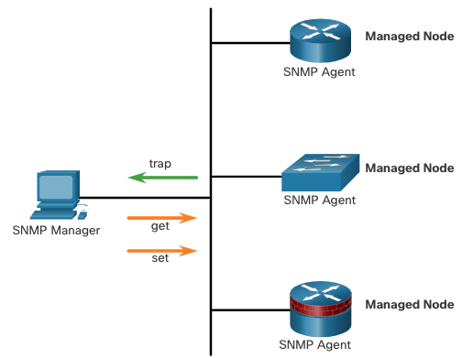
SNMP Introduction to SNMP (Cont.)
The SNMP manager is part of a network management system (NMS). The SNMP manager can collect information from an SNMP agent by using the “get” action and can change configurations on an agent by using the “set” action. SNMP agents can forward information directly to a network manager by using “traps”.
The SNMP agent and MIB reside on SNMP client devices. MIBs store data about the device and operational statistics and are meant to be available to authenticated remote users. The SNMP agent is responsible for providing access to the local MIB.
Notes:
10 - Network Management
10.4 - SNMP
10.4.1 - Introduction to SNMP (Cont.)

Slide 53
SNMP SNMP Operation
SNMP agents that reside on managed devices collect and store information about the device and its operation locally in the MIB. The SNMP manager then uses the SNMP agent to access information within the MIB.
There are two primary SNMP manager requests, get and set. In addition to configuration, a set can cause an action to occur, like restarting a router.
Operation | Description
get-request | Retrieves a value from a specific variable.
get-next-request | Retrieves a value from a variable within a table; the SNMP manager does not need to know the exact variable name. A sequential search is performed to find the needed variable from within a table.
get-bulk-request | Retrieves large blocks of data, such as multiple rows in a table, that would otherwise require the transmission of many small blocks of data. (Only works with SNMPv2 or later.)
get-response | Replies to a get-request, get-next-request, and set-request sent by an NMS.
set-request | Stores a value in a specific variable.
LÄS
LÄS
Notes:
10 - Network Management
10.4 - SNMP
10.4.2 - SNMP Operation

Slide 54
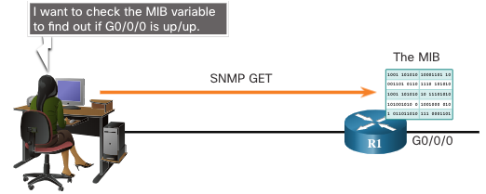
SNMP SNMP Operation (Cont.)
The SNMP agent responds to SNMP manager requests as follows:
Get an MIB variable - The SNMP agent performs this function in response to a GetRequest-PDU from the network manager. The agent retrieves the value of the requested MIB variable and responds to the network manager with that value.
Set an MIB variable - The SNMP agent performs this function in response to a SetRequest-PDU from the network manager. The SNMP agent changes the value of the MIB variable to the value specified by the network manager. An SNMP agent reply to a set request includes the new settings in the device.
LÄS
Notes:
10 - Network Management
10.4 - SNMP
10.4.2 - SNMP Operation (Cont.)

Slide 55
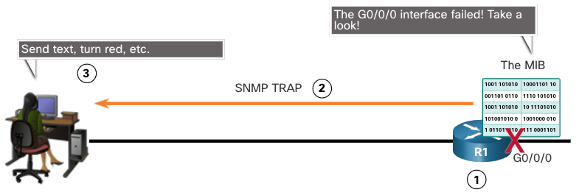
SNMP SNMP Agent Traps
Traps are unsolicited messages alerting the SNMP manager to a condition or event on the network. Trap-directed notifications reduce network and agent resources by eliminating the need for some of SNMP polling requests.
The figure illustrates the use of an SNMP trap to alert the network administrator that interface G0/0/0 has failed. The NMS software can send the network administrator a text message, pop up a window on the NMS software, or turn the router icon red in the NMS GUI.
Notes:
10 - Network Management
10.4 - SNMP
10.4.3 - SNMP Agent Traps

Slide 56
SNMP SNMP Versions
SNMPv1 - Legacy standard defined in RFC 1157. Uses a simple community-string based authentication method. Should not be used due to security risks.
SNMPv2c - Defined in RFCs 1901-1908. Uses a simple community-string based authentication method. Provides for bulk retrieval options, as well as more detailed error messages.
SNMPv3 - Defined in RFCs 3410-3415. Uses username authentication, provides data protection using HMAC-MD5 or HMAC-SHA and encryption using DES, 3DES, or AES encryption.
Notes:
10 - Network Management
10.4 - SNMP
10.4.4 - SNMP Versions
10.4.5 - Check Your Understanding - SNMP Versions

Slide 57
SNMP Community Strings ( ≈ lösenord-ish)
SNMPv1 and SNMPv2c use community strings that control access to the MIB. Community strings are plaintext passwords. SNMP community strings authenticate access to MIB objects.
There are two types of community strings:
Read-only (ro) - This type provides access to the MIB variables, but does not allow these variables to be changed, only read. Because security is minimal in version 2c, many organizations use SNMPv2c in read-only mode.
Read-write (rw) - This type provides read and write access to all objects in the MIB.
To view or set MIB variables, the user must specify the appropriate community string for read or write access.
Notes:
10 - Network Management
10.4 - SNMP
10.4.6 - Community Strings

Slide 58
SNMP MIB Object ID
The MIB organizes variables hierarchically. Formally, the MIB defines each variable as an object ID (OID). OIDs uniquely identify managed objects. The MIB organizes the OIDs based on RFC standards into a hierarchy of OIDs, usually shown as a tree.
The MIB tree for any given device includes some branches with variables common to many networking devices and some branches with variables specific to that device or vendor.
RFCs define some common public variables. Most devices implement these MIB variables. In addition, networking equipment vendors, like Cisco, can define their own private branches of the tree to accommodate new variables specific to their devices.
Notes:
10 - Network Management
10.4 - SNMP
10.4.7 - MIB Object ID

Slide 59
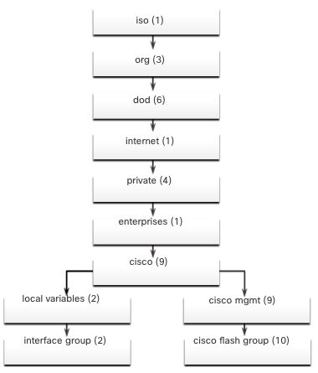
SNMP MIB Object ID (Cont.)
The figure shows portions of the MIB structure defined by Cisco. Note how the OID can be described in words or numbers to help locate a particular variable in the tree.
OIDs belonging to Cisco, are numbered as follows: .iso (1).org (3).dod (6).internet (1).private (4).enterprises (1).cisco (9).
Therefore, the OID is 1.3.6.1.4.1.9.
Notes:
10 - Network Management
10.4 - SNMP
10.4.7 - MIB Object ID (Cont.)

Slide 60
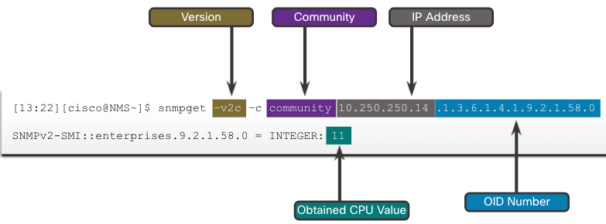
SNMP SNMP Polling Scenario
SNMP can be used is to observe CPU utilization over a period of time by polling devices. CPU statistics can then be compiled on the NMS and graphed. This creates a baseline for the network administrator.
The data is retrieved via the snmpget utility, issued on the NMS. Using the snmpget utility, you can manually retrieve real-time data, or have the NMS run a report. This report would give you a period of time that you could use the data to get the average.
Notes:
10 - Network Management
10.4 - SNMP
10.4.8 - SNMP Polling Scenario

Slide 61
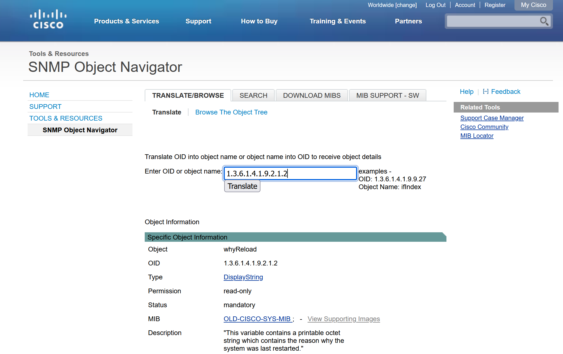
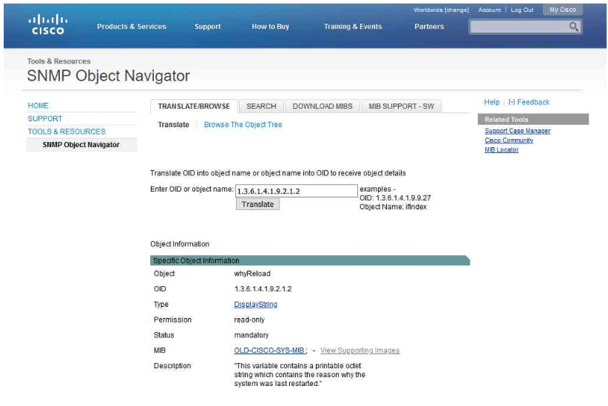
SNMP SNMP Object Navigator
The snmpget utility gives some insight into the basic mechanics of how SNMP works.
However, working with long MIB variable names like 1.3.6.1.4.1.9.2.1.2 can be problematic for the average user. More commonly, the network operations staff uses a network management product with an easy-to-use GUI, which makes the entire MIB data variable naming transparent to the user.
The Cisco SNMP Navigator on the http://www.cisco.com website allows a network administrator to research details about a particular OID.
https://snmp.cloudapps.cisco.com/Support/SNMP/do/BrowseOID.do
Notes:
10 - Network Management
10.4 - SNMP
10.4.9 - SNMP Object Navigator

Slide 62

bye

Slide 63
End of Web

